Slide 1

Web Request Life Cycle
Tenacious​

Slide 2
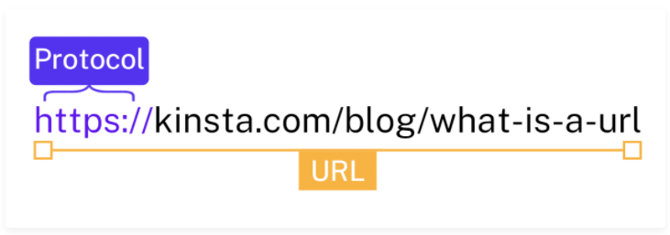
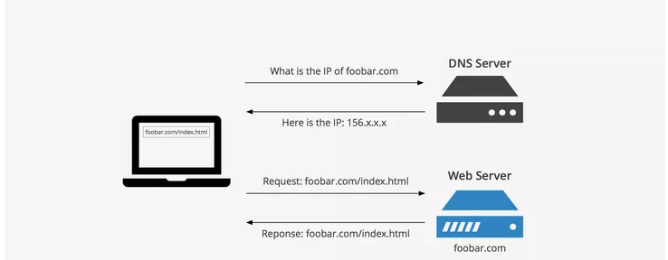
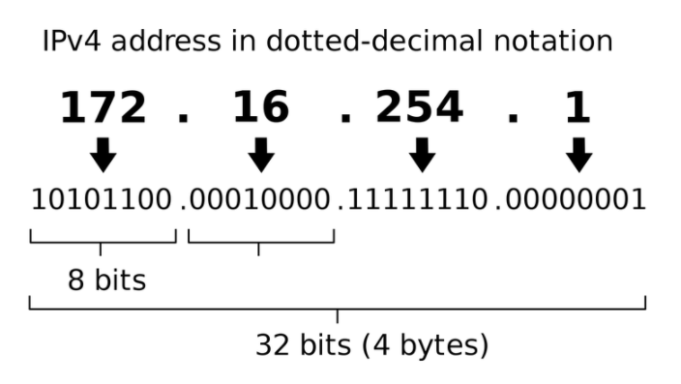
Steps
First the browser needs to translate www.google.com (URL – Uniform Resource Locator) to an IP address if it does not already know it. If it knows it, nothing happens at this point. If it does not know it, it contacts a DNS (Domain Name System) server to resolve the name.
2.Then browser will open a TCP/IP connection to the IP address of www.google.com and send a HTTP GET request over.

Slide 3
You open your browser, the Client, and type in a web address like http://turing.io and hit enter.
The browser takes this address and builds an HTTP Request. It addresses it to the Server located at http://turing.io.
The Request is handed off to your Internet Service Provider (ISP) (like CenturyLink or Comcast) and they send it through the Internet, mostly a series of wires and fiber optic cables, to the Server
The Server reads the Request. It knows how to read it because it is formatted as an HTTP Request.
The Server generates an HTTP Response to that Request.
The server hands the Response off to their ISP and it goes through the internet to arrive at your computer.
Your browser reads the Response. It knows how to read it because it is formatted as an HTTP Response.
Your browser displays the data on your machine.
Notes:
This slide is only for the trainer… You can display the poll from GTM and after the poll is taken, share the result, connect the poll result with the topic. Once done, you can hide the poll so that the PPT is visible.
I have created the poll in the GTM webinar.

Slide 4


